Slide 1
Introducing Machine Learning
Module I

Slide 2
Machine Learning
In the early stages, computers are taught to play simple games of tic-tac-toe and chess.
Later, machines are given control of traffic lights and communications, followed by military drones and missiles.
Now the computers become sentient and learn how to teach themselves.
Having no more need for human programmers, humankind is then "deleted."

Slide 3
Machine Learning
The goal of today's machine learning is not to create an artificial brain, but rather to assist us in making sense of the world's massive data stores.
The field of machine learning provides a set of algorithms that transform data into actionable knowledge.

Slide 4
Machine Learning
From the advent of written language, human observations have been recorded.
Hunters monitored the movement of animal herds, early astronomers recorded the alignment of planets and stars, and cities recorded tax payments, births, and deaths.
Today, such observations, and many more, are increasingly automated and recorded systematically in the ever-growing computerized databases.

Slide 5
The origins of machine learning
The invention of electronic sensors has additionally contributed to an explosion in the volume and richness of recorded data.
Specialized sensors see, hear, smell, taste, and feel. These sensors process the data far differently than a human being would.
Between databases and sensors, many aspects of our lives are recorded.

Slide 6
The origins of machine learning
Governments, businesses, and individuals are recording and reporting information.
Weather sensors record temperature and pressure data
Surveillance cameras watch sidewalks and subway tunnels
All manner of electronic behaviors are monitored: transactions, communications, friendships, and many others.

Slide 7
The origins of machine learning
This deluge of data has led some to state that we have entered an era of Big Data, but this may be a bit of a misnomer.
Human beings have always been surrounded by large amounts of data.
What makes the current era unique is that we have vast amounts of recorded data, much of which can be directly accessed by computers.

Slide 8
The origins of machine learning
Larger and more interesting data sets are increasingly accessible at the tips of our fingers, only a web search away.
This wealth of information has the potential to inform action, given a systematic way of making sense from it all.

Slide 9
The origins of machine learning
The field of study interested in the development of computer algorithms to transform data into intelligent action is known as machine learning.
This field originated in an environment where available data, statistical methods, and computing power rapidly and simultaneously evolved.

Slide 10
The origins of machine learning
Growth in data necessitated additional computing power, which in turn spurred the development of statistical methods to analyze large datasets.
This created a cycle of advancement, allowing even larger and more interesting data to be collected.

Slide 11
The origins of machine learning
A point of distinction between both is
Machine learning focuses on teaching computers how to use data to solve a problem,
while
Data mining focuses on teaching computers to identify patterns that humans then use to solve a problem.

Slide 12
The origins of machine learning

Slide 13
How machines learn
A formal definition of machine learning proposed by computer scientist Tom M. Mitchell states that a machine learns whenever it is able to utilize its experience such that its performance improves on similar experiences in the future.

Slide 14
How machines learn
While human brains are naturally capable of learning from birth, the conditions necessary for computers to learn must be made explicit
Regardless of whether the learner is a human or machine, the basic learning process is similar.

Slide 15
How machines learn
It can be divided into four interrelated components:
Data storage utilizes observation, memory, and recall to provide a factual basis for further reasoning.
Instead of rote learning, memorize a small set of ideas and develop strategies on relating these ideas
Abstraction involves the translation of stored data into broader representations and concepts.
Converting raw data into a model
Mathematical equations
Relational diagrams such as trees or graphs
Logical if else rules
Grouping of data known as clusters

Slide 16
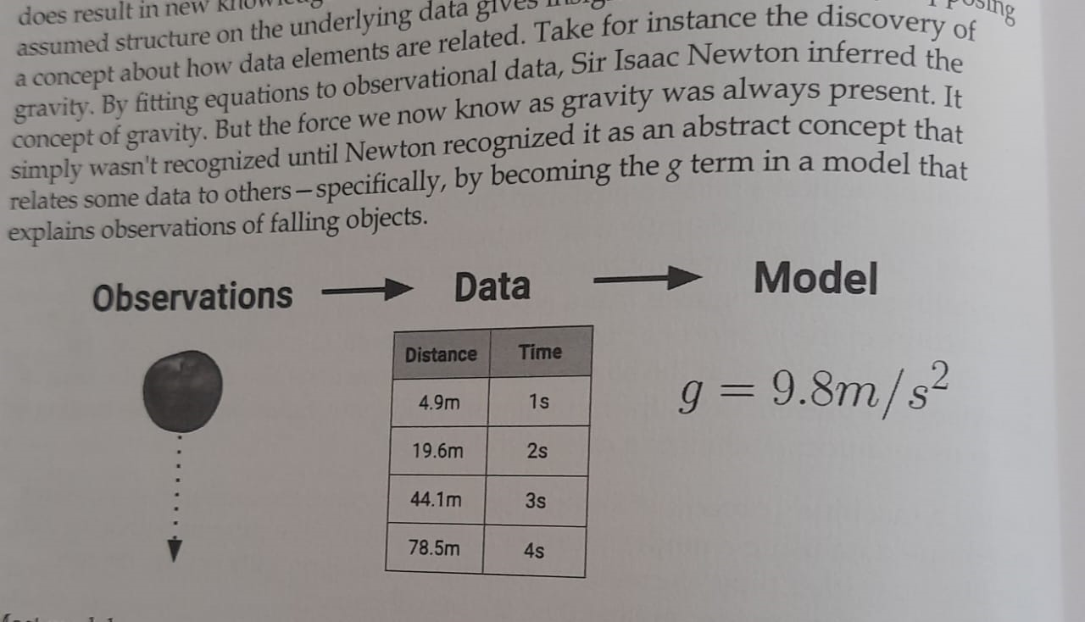

Slide 17
Genomic data-combination of certain genes cause diabetes
Combination of certain personality characteristics may result in new disorders
These information always present but presenting in different format-a new idea can be conceptualised

Slide 18

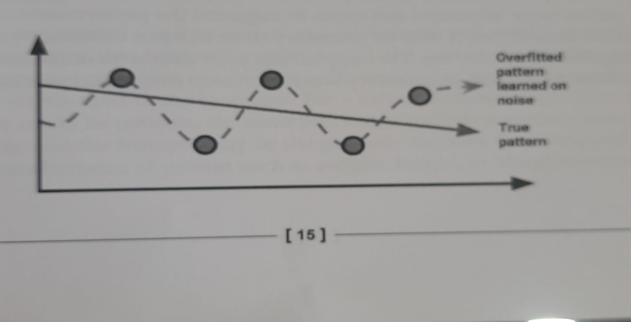
Generalization uses abstracted data for future action
Using it for data not identical but similar to trained data
Sometimes result in illogical conclusions
Air travel better than cars
Evaluation provides a feedback mechanism to measure the utility of learned knowledge and inform potential improvements.
How the algorithm behave on test data
Noise
Overfitting

Slide 19
How machines learn
The following figure illustrates the steps in the learning process:

Slide 20
Machine learning in practice
To apply the learning process to real-world tasks, we'll use a five-step process. Regardless of the task at hand
Any machine learning algorithm can be deployed by following these steps:
Data collection:
Data exploration and preparation:
Model training:
Model evaluation:
Model improvement:

Slide 21
Machine learning in practice
Data collection:
The data collection step involves gathering the learning material, an algorithm will use to generate actionable knowledge.
In most cases, the data will need to be combined into a single source like a text file, spreadsheet, or database.

Slide 22
Machine learning in practice
Data exploration and preparation:
The quality of any machine learning project is based largely on the quality of its input data.
Thus, it is important to learn more about the data and its nuances during a practice called data exploration.
Additional work is required to prepare the data for the learning process.
This involves fixing or cleaning so-called "messy" data, eliminating unnecessary data, and recoding the data to conform to the learner's expected inputs.

Slide 23
Machine learning in practice
Model training:
By the time the data has been prepared for analysis, you are likely to have a sense of what you are capable of learning from the data.
The specific machine learning task chosen will inform the selection of an appropriate algorithm, and the algorithm will represent the data in the form of a model.

Slide 24
Machine learning in practice
Model evaluation:
Because each machine learning model results in a biased solution to the learning problem, it is important to evaluate how well the algorithm learns from its experience.
Depending on the type of model used, you might be able to evaluate the accuracy of the model using a test dataset or you may need to develop measures of performance specific to the intended application.

Slide 25
Machine learning in practice
Model improvement:
If better performance is needed, it becomes necessary to utilize more advanced strategies to augment the performance of the model.
Sometimes, it may be necessary to switch to a different type of model altogether.
You may need to supplement your data with additional data or perform additional preparatory work as in step two of this process.

Slide 26
Machine learning in practice
After these steps are completed, if the model appears to be performing well, it can be deployed for its intended task.
The successes and failures of the deployed model might even provide additional data to train your next generation learner.

Slide 27
Types of Machine learning algorithms
Machine learning algorithms are divided into categories according to their purpose.
Understanding the categories of learning algorithms is an essential first step towards using data to drive the desired action.
Different types of learning models are
Predictive model
Descriptive model and
Meta learners

Slide 28
Types of Machine learning algorithms
A predictive model is used for tasks that involve, the prediction of one value using other values in the dataset.
The learning algorithm attempts to discover and model the relationship between the target feature (the feature being predicted) and the other features.

Slide 29
Types of Machine learning algorithms
A predictive model could be used to predict past events, such as the date of a baby's conception using the mother's present-day hormone levels.
Predictive models can also be used in real time to control traffic lights during rush hours.
Predictive models are given clear instruction on what they need to learn and how they are intended to learn it.

Slide 30
Types of Machine learning algorithms
The process of training a predictive model is known as supervised learning.
The supervision does not refer to human involvement, but the target values provide a way for the learner to know how well it has learned the desired task.
Given a set of data, a supervised learning algorithm attempts to optimize a function (the model) to find the combination of feature values that result in the target output.

Slide 31
Types of Machine learning algorithms
The often used supervised machine learning task of predicting which category an example belongs to is known as classification.
Using Classifier, you could predict whether:
An e-mail message is spam
A person has cancer
A football team will win or lose
An applicant will default on a loan

Slide 32
Types of Machine learning algorithms
In classification,
the target feature to be predicted is a categorical feature known as the class,
and is divided into categories called levels.
A class can have two or more levels, and the levels may or may not be ordinal.

Slide 33
Types of Machine learning algorithms
Supervised learners can also be used to predict numeric data such as
income,
laboratory values,
test scores, or
counts of items.

Slide 34
Types of Machine learning algorithms
A common form of numeric prediction fits linear regression models to the input data.
Regression methods are widely used for forecasting, as they quantify the association between inputs and the target, including both, the magnitude and uncertainty of the relationship.

Slide 35
Types of Machine learning algorithms
The descriptive modeling task called pattern discovery is used to identify useful associations within data.
Pattern discovery is often used for market basket analysis on retailers' transactional purchase data.
The goal is to identify items that are frequently purchased together, such that the learned information can be used to refine marketing tactics.

Slide 36
Types of Machine learning algorithms
If a retailer learns that swimming trunks are commonly purchased at the same time as sunglasses,
the retailer might reposition the items more closely in the store
or run a promotion to "up-sell" customers on associated items.

Slide 37
Types of Machine learning algorithms
A descriptive model is used for tasks that would benefit from the insight gained from summarizing data in new and interesting ways.
In a descriptive model, no single feature is more important than any other.
Since there is no target to learn, the process of training a descriptive model is called unsupervised learning.

Slide 38
Types of Machine learning algorithms
Pattern discovery is now starting to be used in quite innovative ways like
to detect patterns of fraudulent behavior,
screen for genetic defects, or
identify hot spots for criminal activity.

Slide 39
Types of Machine learning algorithms
The descriptive modeling task of dividing a dataset into homogeneous groups is called clustering.
This is sometimes used for segmentation analysis
that identifies groups of individuals with similar behavior or demographic information, so that advertising campaigns could be tailored for particular audiences.

Slide 40
Types of Machine learning algorithms
Although the machine is capable of identifying the clusters, human intervention is required to interpret them.
For example, given five different clusters of shoppers at a grocery store, the marketing team will need to understand the differences among the groups in order to create a promotion that best suits each group.

Slide 41
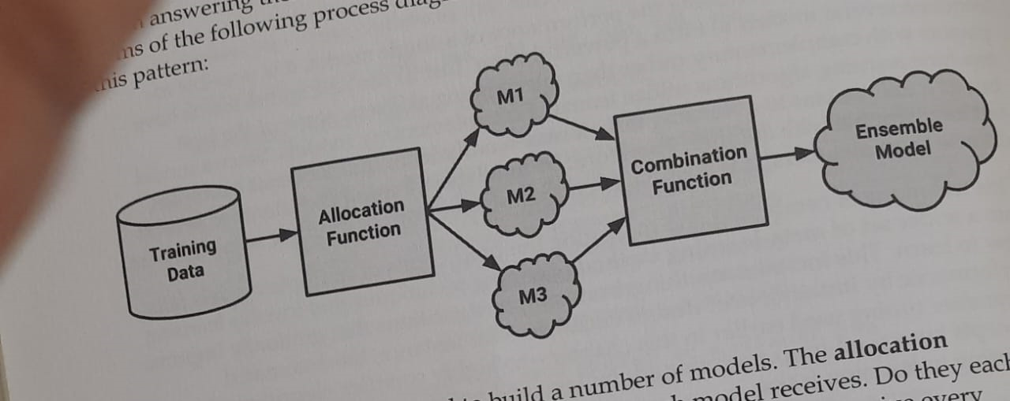
Types of Machine learning algorithms
The technique of combining and managing predictions of multiple models

Slide 42
Types of Machine learning algorithms
Some general types of machine learning algorithms
Model | Learning task
Supervised Learning Algorithms
Nearest Neighbor | Classification
Naïve Bayes | Classification
Decision Trees | Classification
Classification Rule Learners | Classification
Linear Regression | Numeric Prediction
Model Trees | Numeric Prediction
Neural Networks | Dual use
Support Vector Machines | Dual use

Slide 43
Types of Machine learning algorithms
Model | Learning task
Unsupervised Learning Algorithms
Association Rules | Pattern Detection
k-means clustering | Clustering
Meta-Learning Algorithms
Bagging | Dual use
Boosting | Dual use
Random Forest | Dual use

